Slide 1
Revit Logger
Usage;
Log Key data from Revit to Enable change management add-ins and dynamic Revit Export

Slide 2
Components
Revit Addin
Revit External Application to Apply Settings, Activate and Export Log Data
C# CLI/ Service tool to compare Logs to generate “Change” logs triggered after export of log data
Log Format
Json Lines Format
Full Log / Change Data

Slide 3
Revit Logger
Log Naming
FileName_FileGUID_ExternalGUID_UTCTime_Log.jsonl

Slide 4
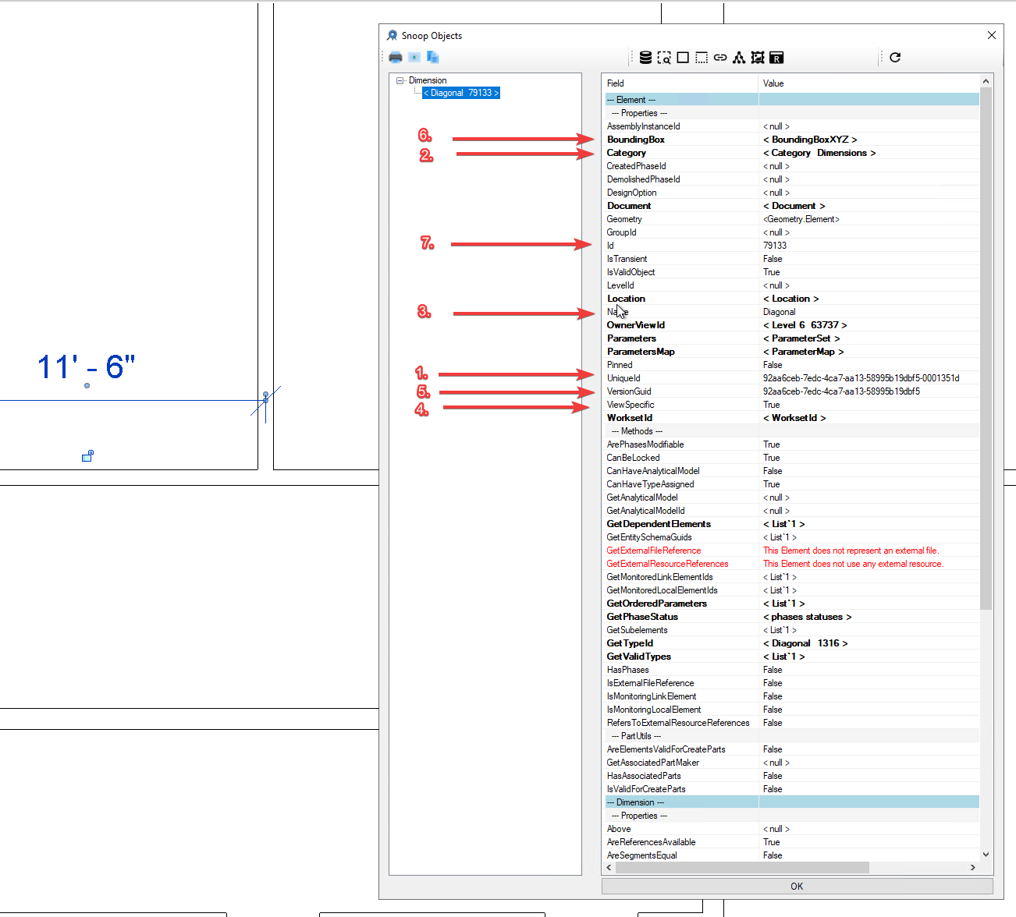
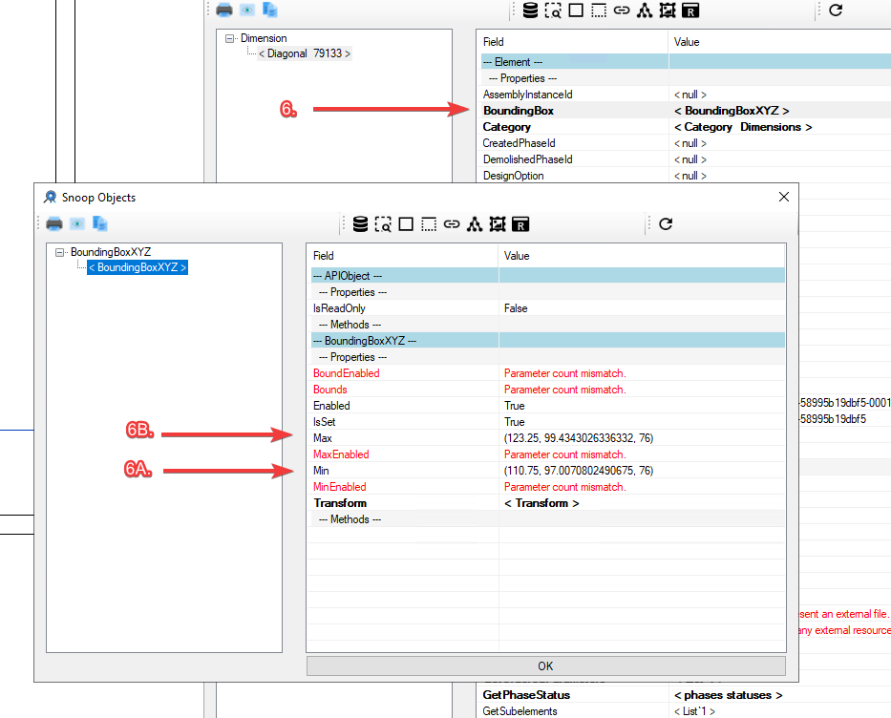
{“ObjectIds”: [“<UniqueId - #1>”, “<Id -#7>”, “<VersionGuid -#5>”], “ObjectProperties”:[“<Name #3>”, “<Category>”, “<ViewSpecific #5>”], “BBox”: [[“<BoundingBoxMin - #6A>”],[“<BoundingBoxMax #6B>”]], “Notes”: [“<UserNote>”, “>ProjectNote>], “ObjectStatus”:”<New,Modified,Deleted>”}

Slide 5
Log Components
ObjectIds – Machine-readable IDs to identify and track changes
{“ObjectIds”: [“<UniqueId>”, “<Id>”, “<VersionGuid>”],
“ObjectProperties”:[“<Name>”, “<Category>”, “<ViewSpecific>”],
“BBox”: [[“<BoundingBoxMin>”],[“<BoundingBoxMax.”]],
“Notes”: [“<UserNote”, “<ProjectNote>],
“ObjectStatus”:”<New,Modified,Deleted,Unchange>”}}
ObjectProperties – User and Machine-readable categories for finding and filtering
BBox – Bounding Box for basic geometric change comparison
Notes – Location for User/ Project Provided Logging of data to be used for change classification
ObjectStatus – Values Calculated from Previous Log that capture status of the object at this point in time.

Slide 6
Log Naming
<FileName>_<RevitModelGUID>_<ExternalID><UTCTime>_Log/Change.jsonl
Log = Full Export
Change = Only Changes from Previous Log

Slide 7
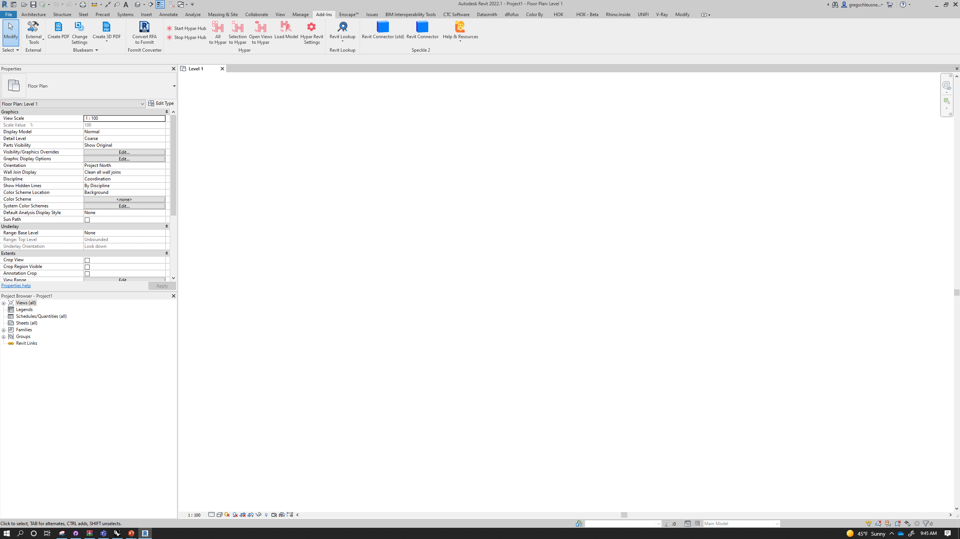






On/Off
Notes
Settings
Select From Log(s)
On/Off
Notes
Settings
Select From Log(s)
Revit Logger
Revit Logger
Revit Logger - Settings
Revit Logger - Notes
Details
Demo
Notes
Demo
Demo
Log Path
User Note
<pick a location to save logs> (required)
<enter a user note (optional)>
Project Name
Project Note
<enter a project name> (required)
<enter a project note (optional)>
Project Number
<enter a project number> (required)
External Project ID
Cancel
Save
<enter a project number> (optional)
Scope
Revit Logger - Progress
All
Model Categories
Annotation Categories
Log Progress
Columns;Ducts;Grids
Import Settings
Cancel
Save

Slide 8
Revision #3

Slide 9
5. Fix as it still references JSON Files
Revit Logger - Settings
On/Off
Notes
Settings
Select From Log(s)
On/Off
Notes
Settings
Select From Log(s)
Details
Revit Logger
Revit Logger
Log Path
#1
<pick a location to save logs> (required)
Revit Logger - Notes
Project Name
#2
Demo
Notes
Demo
<enter a project name> (required)
Demo
Project Number
User Note
<enter a project number> (required)
<enter a user note (optional)>
External Project ID
Project Note
<enter a project number> (optional)
<enter a project note (optional)>
#3
Scope
Cancel
Save
#4
All
Model Categories
Annotation Categories
Columns;Ducts;Grids
Revit Logger - Progress
Log Progress
Import Settings
Cancel
Save
Changes;
Move “Log Path” to a text file that lives with the installer on a user's machine. This is something that wants to be consistent across a company. (Remove from UI) – Change the name of the path to “Project Root”
Move Project Name/ Project Number/ and External Project ID to Extensible Storage values (if they are not already)
Add “Model Name” and “Model Discipline” to the “Details” section and make Extensible Storage
Remove the “Scope” section from the UI and Merge Features into “Log Filter Settings” – See Next Page

Slide 10
Log Filter
6. “Log Filter Settings” File
Create a Text file in the Project Folder under …/ProjectRoot/Project/logsettings
This file should be read at Log Export time to determine items to be exported
The options should include;
Model Categories (yes/no)
Annotation Categories (yes/no)
Views (yes/no)
Schedules (yes/no)
Details (yes/no)
Sheets (yes/no)
Model Views (yes/no)
Legends (yes/no)
Family Types (yes/no)
Links (yes/no)
Imported Categories (yes/no)
Other?
The goal should be that if only model categories are set to yes, that the only changes that are exporter to the log are “Placed Instances in the host file of 3D elements)”

